Slide 1

Bioinformatics
Pairwise alignment Part 2

Slide 2
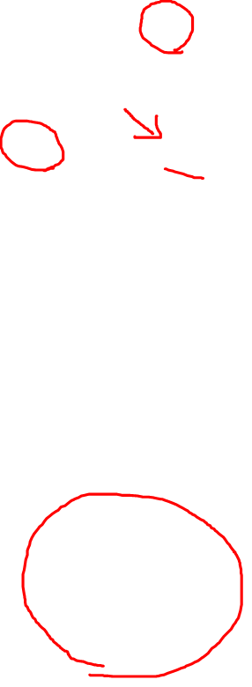
Dynamic Programming
GAP |  | A |  | T |  | T
 | 0 | -1 | -1 | -2 | -2 | -3 | -3
T | -1 | -1 | -2 | 0 | -3 | -1 | -4
 | -1 | -2 | -1 | -2 | 0 | -1 | -1
T | -2 | -2 | -2 | 0 | -1 | 1 | -2
 | -2 | -3 | -2 | -3 | 0 | -1 | 1
C | -3 | -3 | -3 | -3 | -1 | -1 | 0
 | -3 | -4 | -3 | -4 | -1 | -2 | 0
Scoring scheme
Match: +1 s(xi,yj)
Mismatch: -1
Deletion/insertion: -1 (d)
F(i-1,j-1) + s(xi,yi) | F(i,j-1) -d
F(i-1,j) -d | Max(F(i,j))
gap
gap
substitution
-1
-1 -1
-1 -1
xi
yi
A
T
A-
-T
-A
T-
Optimal alignment
ATT-
-TTC
substitution
Del/ins
Ins/del
Notes:
…a mismatch scores -1

Slide 3
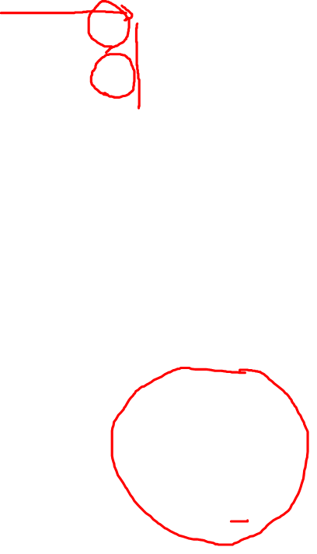
Dynamic Programming
GAP |  | A |  | T |  | T
 | 0 | -1 | -1 | -2 | -2 | -3 | -3
T | -1 | -1 | -2 | 0 | -3 | -1 | -4
 | -1 | -2 | -1 | -2 | 0 | -1 | -1
T | -2 | -2 | -2 | 0 | -1 | 1 | -2
 | -2 | -3 | -2 | -3 | 0 | -1 | 1
C | -3 | -3 | -3 | -3 | -1 | -1 | 0
 | -3 | -4 | -3 | -4 | -1 | -2 | 0
Scoring scheme
Match: +1 s(xi,yj)
Mismatch: -1
Deletion/insertion: -1 (d)
F(i-1,j-1) + s(xi,yi) | F(i,j-1) -d
F(i-1,j) -d | Max(F(i,j))
gap
gap
substitution
-1
-1 -1
-1 -1
xi
yi
A
T
A-
-T
-A
T-
Optimal alignment
ATT-
-TTC
substitution
Del/ins
Ins/del
Notes:
…for this possible alignment

Slide 4

Dynamic Programming
GAP |  | A |  | T |  | T
 | 0 | -1 | -1 | -2 | -2 | -3 | -3
T | -1 | -1 | -2 | 0 | -3 | -1 | -4
 | -1 | -2 | -1 | -2 | 0 | -1 | -1
T | -2 | -2 | -2 | 0 | -1 | 1 | -2
 | -2 | -3 | -2 | -3 | 0 | -1 | 1
C | -3 | -3 | -3 | -3 | -1 | -1 | 0
 | -3 | -4 | -3 | -4 | -1 | -2 | 0
Scoring scheme
Match: +1 s(xi,yj)
Mismatch: -1
Deletion/insertion: -1 (d)
F(i-1,j-1) + s(xi,yi) | F(i,j-1) -d
F(i-1,j) -d | Max(F(i,j))
gap
gap
substitution
-1
-1 -1
-1 -1
xi
yi
A
T
A-
-T
-A
T-
Optimal alignment
ATT-
-TTC
substitution
Del/ins
Ins/del
Notes:
…as the final score

Slide 5

Dynamic Programming
GAP |  | A |  | T |  | T
 | 0 | -1 | -1 | -2 | -2 | -3 | -3
T | -1 | -1 | -2 | 0 | -3 | -1 | -4
 | -1 | -2 | -1 | -2 | 0 | -1 | -1
T | -2 | -2 | -2 | 0 | -1 | 1 | -2
 | -2 | -3 | -2 | -3 | 0 | -1 | 1
C | -3 | -3 | -3 | -3 | -1 | -1 | 0
 | -3 | -4 | -3 | -4 | -1 | -2 | 0
Scoring scheme
Match: +1 s(xi,yj)
Mismatch: -1
Deletion/insertion: -1 (d)
F(i-1,j-1) + s(xi,yi) | F(i,j-1) -d
F(i-1,j) -d | Max(F(i,j))
gap
gap
substitution
-1
-1 -1
-1 -1
xi
yi
A
T
A-
-T
-A
T-
Optimal alignment
ATT-
-TTC
substitution
Ins/del
Del/ins

Slide 6
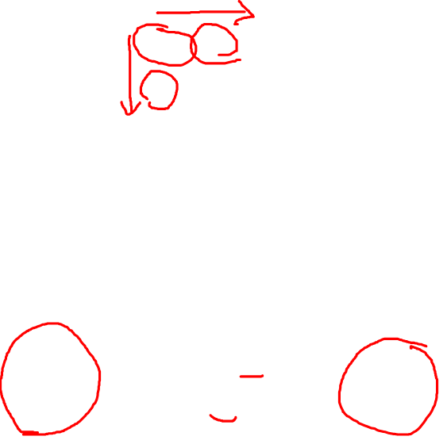
Dynamic Programming
GAP |  | A |  | T |  | T
 | 0 | -1 | -1 | -2 | -2 | -3 | -3
T | -1 | -1 | -2 | 0 | -3 | -1 | -4
 | -1 | -2 | -1 | -2 | 0 | -1 | -1
T | -2 | -2 | -2 | 0 | -1 | 1 | -2
 | -2 | -3 | -2 | -3 | 0 | -1 | 1
C | -3 | -3 | -3 | -3 | -1 | -1 | 0
 | -3 | -4 | -3 | -4 | -1 | -2 | 0
Use residue in first sequence and introduce gap in second Seq
Use residue in second sequence and introduce gap in first Seq
xi
yi
AT
TT
AT
T-
A-
TT
substitution
Notes:
Error in the recording -1 should have been -2 in the horizontal alignment

Slide 7
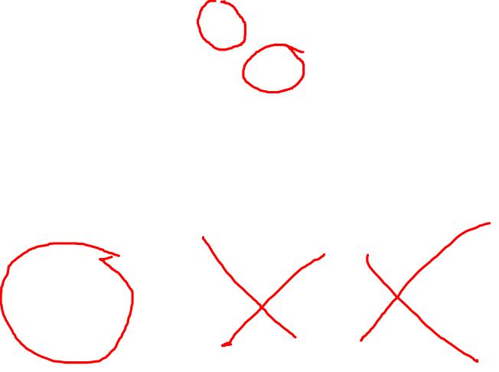
Dynamic Programming
GAP |  | A |  | T |  | T
 | 0 | -1 | -1 | -2 | -2 | -3 | -3
T | -1 | -1 | -2 | 0 | -3 | -1 | -4
 | -1 | -2 | -1 | -2 | 0 | -1 | -1
T | -2 | -2 | -2 | 0 | -1 | 1 | -2
 | -2 | -3 | -2 | -3 | 0 | -1 | 1
C | -3 | -3 | -3 | -3 | -1 | -1 | 0
 | -3 | -4 | -3 | -4 | -1 | -2 | 0
All possible best subalignments that use 2 NT in each seq
xi
yi
AT
TT
AT-
-TT
-AT
TT-
substitution
Notes:
…would be pruned and you would not consider them anymore

Slide 8
Dynamic Programming
PAM250

Slide 9
Dynamic Programming
Gap open penalty: -12
Gap extension parameter: -4
PAM250
completing_alignment_matrix.mp4

Slide 10
Dynamic Programming
Affine gap cost
Gap open : -12
Gap Extension: -4
Substitution cost: PAM250
L
S
L
S
Notes:
If you have longer alignment, It can become more complicated

Slide 11
Affine gap cost
Gap open : -12
Gap Extension: -4
Substitution cost: PAM250
gap
gap
substitution
M N A - L S D R T
M G S D R T T E T

Slide 12
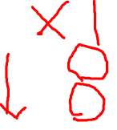
Affine gap cost
Gap open : -12
Gap Extension: -4
Substitution cost: PAM250
gap
gap
substitution
M N A - L S D R T
M G S D R T T E T

Slide 13

Affine gap cost
Gap open : -12
Gap Extension: -4
Substitution cost: PAM250
gap
gap
substitution
M - N A L S D R T M G S D R T T E T

Slide 14
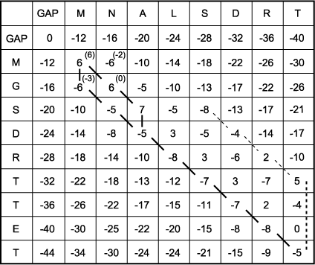
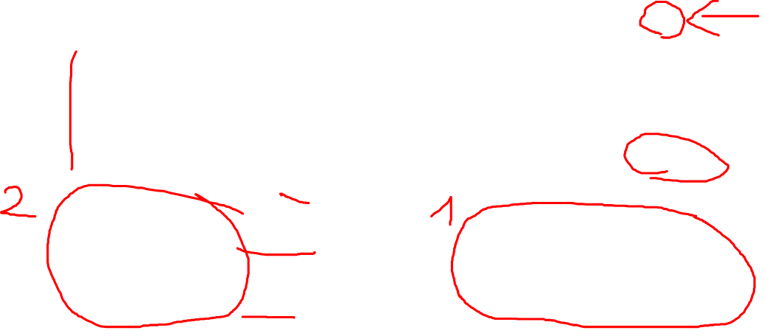
Dynamic Programming
MNALSDRT---
--MGSDRTTET
MNA-LSDRT
MGSDRTTET

Slide 15
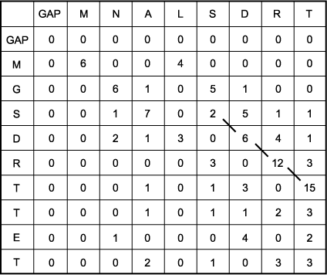
Dynamic Programming
Local Alignment: Smith Waterman
No negative scores are allowed
Portions of each sequence that are in the high scoring regions are reported
SDRT
SDRT
Notes:
…In this case this is the better alignment

